Slide 1
CS162 Operating Systems and Systems Programming Lecture 7 Synchronization 2: Concurrency (Con’t), Mutual Exclusion, Lock Implementation, Atomic Operations
February 7th, 2023
Prof. John Kubiatowicz
http://cs162.eecs.Berkeley.edu

Slide 2
Recall: Use of Threads
Version of program with Threads (loose syntax):
main() {
ThreadFork(ComputePI, “pi.txt” ));
ThreadFork(PrintClassList, “classlist.txt”));
}
What does ThreadFork() do?
Start independent thread running given procedure
What is the behavior here?
Now, you would actually see the class list
This should behave as if there are two separate CPUs
CPU1
CPU2
CPU1
CPU2
CPU1
CPU2
Time

Slide 3
Recall: Memory Footprint for Two-Threads
If we stopped this program and examined it with a debugger, we would see
Two sets of CPU registers
Two sets of Stacks
Questions:
How do we position stacks relative to each other?
What maximum size should we choose for the stacks?
What happens if threads violate this?
How might you catch violations?
What about n>2 threads?
Stack 1
Stack 2
Address Space
Heap
Global Data
Code

Slide 4
Recall: the Dispatch Loop
Conceptually, the scheduling loop of the operating system looks as follows:
Loop {
RunThread(); /* Needs to exit every now and then! */
ChooseNextThread();
SaveStateOfCPU(curTCB);
LoadStateOfCPU(newTCB);
}
This is an infinite loop
One could argue that this is all that the OS does
Should we ever exit this loop???
When would that be?
Notes:
Emergency crash of operating system called “panic()”

Slide 5
Recall: Running a thread
Consider first portion: RunThread()
How do I run a thread?
Load its state (registers, PC, stack pointer) into CPU
Load environment (virtual memory space, etc)
Jump to the PC
How does the dispatcher get control back?
Internal events: thread returns control voluntarily
External events: thread gets preempted
Notes:
OS’s have almost human characteristics – unpredictable, hard to understand, …
Different things share the same CPU – one thread, then another
Similar to schizophrenia, like the movie Sybil, one body shared by several people, say we start with Dave Patterson
Threads are like the personalities of the CPU. First one thread/personality uses the CPU, then another,…

Slide 6
Internal Events
Blocking on I/O
The act of requesting I/O implicitly yields the CPU
Waiting on a “signal” from other thread
Thread asks to wait and thus yields the CPU
Thread executes a yield()
Thread volunteers to give up CPU
computePI() {
while(TRUE) {
ComputeNextDigit();
yield();
}
}
Notes:
Yield is for really nice people – Ever see two people at the supermarket checkout line? You first, no you first, …

Slide 7
Stack for Yielding Thread
ComputePI
yield
Trap to OS
kernel_yield
Stack growth
run_new_thread
switch
How do we run a new thread?
run_new_thread() {
newThread = PickNewThread();
switch(curThread, newThread);
ThreadHouseKeeping(); /* Do any cleanup */
}
How does dispatcher switch to a new thread?
Save anything next thread may trash: PC, regs, stack pointer
Maintain isolation for each thread

Slide 8
What Do the Stacks Look Like?
Consider the following code blocks:
proc A() {
B();
}
proc B() {
while(TRUE) {
yield();
}
}
Suppose we have 2 threads:
Threads S and T
Thread S
Thread T
A
A
B(while)
B(while)
Stack growth
yield
yield
run_new_thread
run_new_thread
switch
switch
Thread S's switch returns to Thread T's (and vice versa)

Slide 9
Saving/Restoring state (often called “Context Switch)
Switch(tCur,tNew) {
/* Unload old thread */
TCB[tCur].regs.r7 = CPU.r7;
…
TCB[tCur].regs.r0 = CPU.r0;
TCB[tCur].regs.sp = CPU.sp;
TCB[tCur].regs.retpc = CPU.retpc; /*return addr*/
/* Load and execute new thread */
CPU.r7 = TCB[tNew].regs.r7;
…
CPU.r0 = TCB[tNew].regs.r0;
CPU.sp = TCB[tNew].regs.sp;
CPU.retpc = TCB[tNew].regs.retpc;
return; /* Return to CPU.retpc */
}

Slide 10
Switch Details (continued)
What if you make a mistake in implementing switch?
Suppose you forget to save/restore register 32
Get intermittent failures depending on when context switch occurred and whether new thread uses register 32
System will give wrong result without warning
Can you devise an exhaustive test to test switch code?
No! Too many combinations and inter-leavings
Cautionary tale:
For speed, Topaz kernel saved one instruction in switch()
Carefully documented! Only works as long as kernel size < 1MB
What happened?
Time passed, People forgot
Later, they added features to kernel (no one removes features!)
Very weird behavior started happening
Moral of story: Design for simplicity

Slide 11
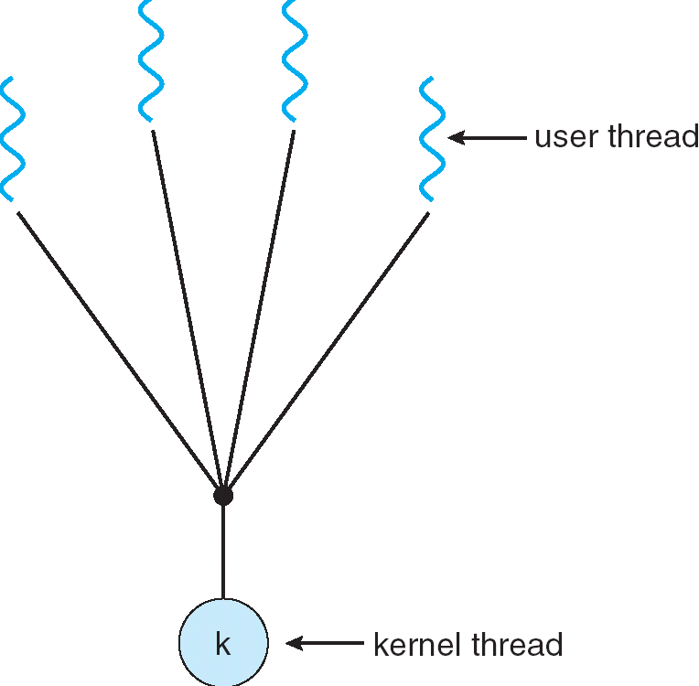
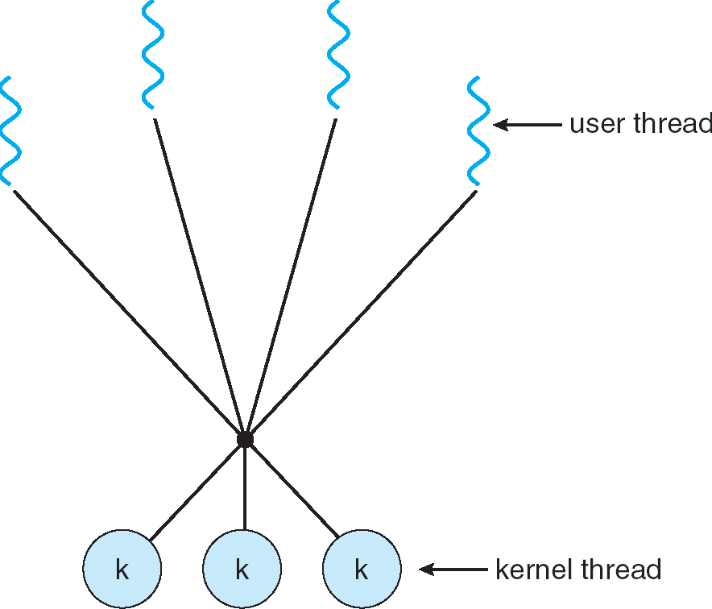
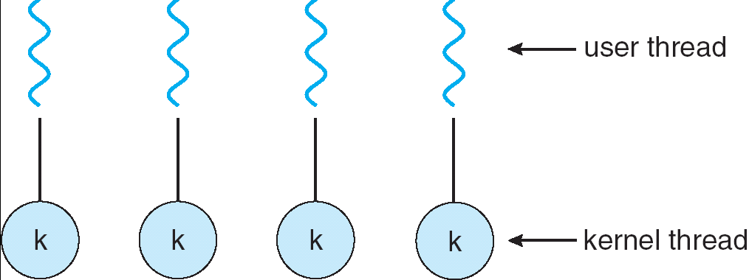
How expensive is context switching?
Switching between threads in same process similar to switching between threads in different processes, but much cheaper:
No need to change address space
Some numbers from Linux:
Frequency of context switch: 10-100ms
Switching between processes: 3-4 μsec.
Switching between threads: 100 ns
Even cheaper: switch threads (using “yield”) in user-space!
What we are talking about in Today’s lecture
Simple One-to-One
Threading Model
Many-to-One
Many-to-Many

Slide 12
What happens when thread blocks on I/O?
CopyFile
read
Trap to OS
Stack growth
kernel_read
run_new_thread
switch
What happens when a thread requests a block of data from the file system?
User code invokes a system call
Read operation is initiated
Run new thread/switch
Thread communication similar
Wait for Signal/Join
Networking

Slide 13
External Events
What happens if thread never does any I/O, never waits, and never yields control?
Could the ComputePI program grab all resources and never release the processor?
What if it didn’t print to console?
Must find way that dispatcher can regain control!
Answer: utilize external events
Interrupts: signals from hardware or software that stop the running code and jump to kernel
Timer: like an alarm clock that goes off every some milliseconds
If we make sure that external events occur frequently enough, can ensure dispatcher runs
Notes:
Patterson’s a nice guy, so he gives up the body after using it for awhile and let’s John Kubitowicz have it.
But Kubi’s not so nice, so he won’t give up control…
If you want to wake up for a final, you set your clock, or ask your roommate to pour water over your head – OS does the same

Slide 14
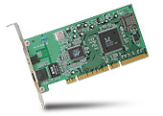
Recall: Interrupt Controller
Interrupt Mask
Priority Encoder
IntID
CPU
Interrupt
Int Disable
Timer
Software
Interrupt
Control
NMI
Network
Interrupts invoked with interrupt lines from devices
Interrupt controller chooses interrupt request to honor
Interrupt identity specified with ID line
Mask enables/disables interrupts
Priority encoder picks highest enabled interrupt
Software Interrupt Set/Cleared by Software
CPU can disable all interrupts with internal flag
Non-Maskable Interrupt line (NMI) can’t be disabled

Slide 15
Example: Network Interrupt
Raise priority
(set mask)
Reenable All Ints
Save registers
Dispatch to Handler
…
Transfer Network Packet from hardware to Kernel Buffers
…
Restore registers
Clear current Int
Disable All Ints
Restore priority
(clear Mask)
RTI
...
add $r1,$r2,$r3
subi $r4,$r1,#4
slli $r4,$r4,#2
...
PC saved
Disable All Ints
Kernel Mode
External Interrupt
Pipeline Flush
“Interrupt Handler”
...
lw $r2,0($r4)
lw $r3,4($r4)
add $r2,$r2,$r3
sw 8($r4),$r2
...
Restore PC
Enable all Ints
User Mode
An interrupt is a hardware-invoked context switch
No separate step to choose what to run next
Always run the interrupt handler immediately

Slide 16
Use of Timer Interrupt to Return Control
Solution to our dispatcher problem
Use the timer interrupt to force scheduling decisions
Timer Interrupt routine:
TimerInterrupt() { DoPeriodicHouseKeeping(); run_new_thread(); }
Some Routine
Interrupt
TimerInterrupt
Stack growth
run_new_thread
switch

Slide 17
Administrivia
Midterm Thursday 2/16
No class on day of midterm
7-9PM
Project 1 Design Document due next Friday 2/10
Project 1 Design reviews upcoming
High-level discussion of your approach
What will you modify?
What algorithm will you use?
How will things be linked together, etc.
Do not need final design (complete with all semicolons!)
You will be asked about testing
Understand testing framework
Are there things you are doing that are not tested by tests we give you?
Do your own work!
Please do not try to find solutions from previous terms
We will be on the look out for anyone doing this…today

Slide 18
ThreadFork(): Create a New Thread
ThreadFork() is a user-level procedure that creates a new thread and places it on ready queue
Arguments to ThreadFork()
Pointer to application routine (fcnPtr)
Pointer to array of arguments (fcnArgPtr)
Size of stack to allocate
Implementation
Sanity check arguments
Enter Kernel-mode and Sanity Check arguments again
Allocate new Stack and TCB
Initialize TCB and place on ready list (Runnable)

Slide 19
How do we initialize TCB and Stack?
Initialize Register fields of TCB
Stack pointer made to point at stack
PC return address ⇒ OS (asm) routine ThreadRoot()
Two arg registers (a0 and a1) initialized to fcnPtr and fcnArgPtr, respectively
Initialize stack data?
Minimal initialization ⇒setup return to go to beginning of ThreadRoot()
Important part of stack frame is in registers for RISC-V (ra)
X86: need to push a return address on stack
Think of stack frame as just before body of ThreadRoot() really gets started
ThreadRoot stub
Stack growth
Initial Stack

Slide 20
How does Thread get started?
Other Thread
ThreadRoot
A
B(while)
Stack growth
yield
run_new_thread
New Thread
switch
ThreadRoot stub
Eventually, run_new_thread() will select this TCB and return into beginning of ThreadRoot()
This really starts the new thread

Slide 21
How does a thread get started?
Other Thread
SetupNewThread(tNew) {
…
TCB[tNew].regs.sp = newStackPtr;
TCB[tNew].regs.retpc = &ThreadRoot;
TCB[tNew].regs.r0 = fcnPtr TCB[tNew].regs.r1 = fcnArgPtr
}
ThreadRoot
A
B(while)
Stack growth
yield
run_new_thread
New Thread
switch
ThreadRoot stub
How do we make a new thread?
Setup TCB/kernel thread to point at new user stack and ThreadRoot code
Put pointers to start function and args in registers or top of stack
This depends heavily on the calling convention (i.e. RISC-V vs x86)
Eventually, run_new_thread() will select this TCB and return into beginning of ThreadRoot()
This really starts the new thread

Slide 22
What does ThreadRoot() look like?
ThreadRoot() is the root for the thread routine:
ThreadRoot(fcnPTR,fcnArgPtr) {
DoStartupHousekeeping();
UserModeSwitch(); /* enter user mode */
Call fcnPtr(fcnArgPtr);
ThreadFinish();
}
Startup Housekeeping
Includes things like recording start time of thread
Other statistics
Stack will grow and shrink with execution of thread
Final return from thread returns into ThreadRoot() which calls ThreadFinish()
ThreadFinish() wake up sleeping threads
ThreadRoot
Thread Code *fcnPtr()
Stack growth
Running Stack

Slide 23
Processes vs. Threads: One Core
Process 1
Process N
Switch overhead:
Same process: low
Different proc.: high
Protection
Same proc: low
Different proc: high
Sharing overhead
Same proc: low
Different proc: high
Parallelism: no
threads
threads
Mem.
Mem.
…
IO
state
…
…
IO
state
CPU
state
CPU
state
CPU
state
CPU
state
CPU sched.
OS
1 thread at a time
CPU
(1 core)

Slide 24
Processes vs. Threads: MultiCore
Process 1
Process N
Switch overhead:
Same process: low
Different proc.: high
Protection
Same proc: low
Different proc: high
Sharing overhead
Same proc: low
Different proc, simultaneous core: medium
Different proc, offloaded core: high
Parallelism: yes
threads
threads
Mem.
Mem.
…
IO
state
…
…
IO
state
CPU
state
CPU
state
CPU
state
CPU
state
CPU sched.
OS
4 threads at a time
Core 1
Core 2
Core 3
Core 4

Slide 25
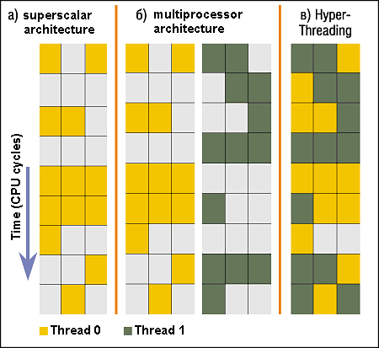
Recall: Simultaneous MultiThreading/Hyperthreading
Hardware scheduling technique
Superscalar processors can execute multiple instructions that are independent.
Hyperthreading duplicates register state to make a second “thread,” allowing more instructions to run.
Can schedule each thread as if were separate CPU
But, sub-linear speedup!
Original technique called “Simultaneous Multithreading”
http://www.cs.washington.edu/research/smt/index.html
SPARC, Pentium 4/Xeon (“Hyperthreading”), Power 5
Colored blocks show
instructions executed
Notes:
Intel seems to be discarding SMT in Silvermont because of power problems

Slide 26
Processes vs. Threads: Hyper-Threading
Process 1
Process N
threads
threads
Switch overhead between hardware-threads: very-low (done in hardware)
Contention for ALUs/FPUs may hurt performance
Mem.
Mem.
…
IO
state
…
…
IO
state
CPU
state
CPU
state
CPU
state
CPU
state
CPU sched.
OS
hardware-threads
(hyperthreading)
8 threads at a time
Core 1
Core 2
Core 3
Core 4
CPU

Slide 27
Threads vs Address Spaces: Options
One
Many
# of addr spaces:
# threads
Per AS:
One
MS/DOS, early Macintosh
Traditional UNIX
Many
Embedded systems (Geoworks, VxWorks, JavaOS,etc)
JavaOS, Pilot(PC)
Mach, OS/2, Linux
Windows 10
Win NT to XP, Solaris, HP-UX, OS X
Most operating systems have either
One or many address spaces
One or many threads per address space

Slide 28
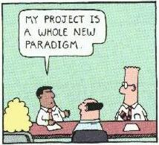
Goals for Rest of Today
Challenges and Pitfalls of Concurrency
Synchronization Operations/Critical Sections
How to build a lock?
Atomic Instructions

Slide 29
Multiprocessing vs Multiprogramming
Some Definitions:
Multiprocessing ≡ Multiple CPUs
Multiprogramming ≡ Multiple Jobs or Processes
Multithreading ≡ Multiple threads per Process
What does it mean to run two threads “concurrently”?
Scheduler is free to run threads in any order and interleaving: FIFO, Random, …
Dispatcher can choose to run each thread to completion or time-slice in big chunks or small chunks
A
Multiprocessing
B
C
A
B
C
Multiprogramming
A
B
C
A
B
C
B

Slide 30
ATM Bank Server
ATM server problem:
Service a set of requests
Do so without corrupting database
Don’t hand out too much money

Slide 31
ATM bank server example
Suppose we wanted to implement a server process to handle requests from an ATM network:
BankServer() { while (TRUE) { ReceiveRequest(&op, &acctId, &amount); ProcessRequest(op, acctId, amount); } }
ProcessRequest(op, acctId, amount) { if (op == deposit) Deposit(acctId, amount); else if … }
Deposit(acctId, amount) { acct = GetAccount(acctId); /* may use disk I/O */ acct->balance += amount; StoreAccount(acct); /* Involves disk I/O */ }
How could we speed this up?
More than one request being processed at once
Event driven (overlap computation and I/O)
Multiple threads (multi-proc, or overlap comp and I/O)

Slide 32
Event Driven Version of ATM server
Suppose we only had one CPU
Still like to overlap I/O with computation
Without threads, we would have to rewrite in event-driven style
Example
BankServer() { while(TRUE) { event = WaitForNextEvent(); if (event == ATMRequest) StartOnRequest(); else if (event == AcctAvail) ContinueRequest(); else if (event == AcctStored) FinishRequest(); } }
This technique is used for graphical programming
Complication:
What if we missed a blocking I/O step?
What if we have to split code into hundreds of pieces which could be blocking?

Slide 33
Can Threads Make This Easier?
Threads yield overlapped I/O and computation without “deconstructing” code into non-blocking fragments
One thread per request
Requests proceeds to completion, blocking as required:
Deposit(acctId, amount) { acct = GetAccount(actId); /* May use disk I/O */ acct->balance += amount; StoreAccount(acct); /* Involves disk I/O */ }
Unfortunately, shared state can get corrupted: Thread 1 Thread 2 load r1, acct->balance load r1, acct->balance add r1, amount2 store r1, acct->balance add r1, amount1 store r1, acct->balance

Slide 34
Recall: Possible Executions

Slide 35
Problem is at the Lowest Level
Most of the time, threads are working on separate data, so scheduling doesn’t matter:
Thread A Thread B
x = 1; y = 2;
However, what about (Initially, y = 12):
Thread A Thread B
x = 1; y = 2;
x = y+1; y = y*2;
What are the possible values of x?
Or, what are the possible values of x below?
Thread A Thread B
x = 1; x = 2;
X could be 1 or 2 (non-deterministic!)
Could even be 3 for serial processors:
Thread A writes 0001, B writes 0010 → scheduling order ABABABBA yields 3!
Notes:
X could be (13, 5, 3)

Slide 36
Atomic Operations
To understand a concurrent program, we need to know what the underlying indivisible operations are!
Atomic Operation: an operation that always runs to completion or not at all
It is indivisible: it cannot be stopped in the middle and state cannot be modified by someone else in the middle
Fundamental building block – if no atomic operations, then have no way for threads to work together
On most machines, memory references and assignments (i.e. loads and stores) of words are atomic
Consequently – weird example that produces “3” on previous slide can’t happen
Many instructions are not atomic
Double-precision floating point store often not atomic
VAX and IBM 360 had an instruction to copy a whole array

Slide 37
Another Concurrent Program Example
Two threads, A and B, compete with each other
One tries to increment a shared counter
The other tries to decrement the counter
Thread A Thread B
i = 0; i = 0; while (i < 10) while (i > -10) i = i + 1; i = i – 1; printf(“A wins!”); printf(“B wins!”);
Assume that memory loads and stores are atomic, but incrementing and decrementing are not atomic
Who wins? Could be either
Is it guaranteed that someone wins? Why or why not?
What if both threads have their own CPU running at same speed? Is it guaranteed that it goes on forever?

Slide 38
Hand Simulation Multiprocessor Example
Inner loop looks like this:
Thread A Thread B
r1=0 load r1, M[i]
r1=0 load r1, M[i]
r1=1 add r1, r1, 1
r1=-1 sub r1, r1, 1
M[i]=1 store r1, M[i]
M[i]=-1 store r1, M[i]
Hand Simulation:
And we’re off. A gets off to an early start
B says “hmph, better go fast” and tries really hard
A goes ahead and writes “1”
B goes and writes “-1”
A says “HUH??? I could have sworn I put a 1 there”
Could this happen on a uniprocessor? With Hyperthreads?
Yes! Unlikely, but if you are depending on it not happening, it will and your system will break…

Slide 39
Definitions
Synchronization: using atomic operations to ensure cooperation between threads
For now, only loads and stores are atomic
We are going to show that its hard to build anything useful with only reads and writes
Mutual Exclusion: ensuring that only one thread does a particular thing at a time
One thread excludes the other while doing its task
Critical Section: piece of code that only one thread can execute at once. Only one thread at a time will get into this section of code
Critical section is the result of mutual exclusion
Critical section and mutual exclusion are two ways of describing the same thing

Slide 40
Locks
Lock: prevents someone from doing something
Lock() before entering critical section and before accessing shared data
Unlock() when leaving, after accessing shared data
Wait if locked
Important idea: all synchronization involves waiting
Locks need to be allocated and initialized:
structure Lock mylock or pthread_mutex_t mylock;
lock_init(&mylock) or mylock = PTHREAD_MUTEX_INITIALIZER;
Locks provide two atomic operations:
acquire(&mylock) – wait until lock is free; then mark it as busy
After this returns, we say the calling thread holds the lock
release(&mylock) – mark lock as free
Should only be called by a thread that currently holds the lock
After this returns, the calling thread no longer holds the lock

Slide 41
Fix banking problem with Locks!
Identify critical sections (atomic instruction sequences) and add locking:
Deposit(acctId, amount) {
acquire(&mylock) // Wait if someone else in critical section! acct = GetAccount(actId); acct->balance += amount; StoreAccount(acct);
release(&mylock) // Release someone into critical section }
Must use SAME lock (mylock) with all of the methods (Withdraw, etc…)
Shared with all threads!
Critical Section
Thread B
Thread A
Thread C
Threads serialized by lock through critical section.
Only one thread at a time
acquire(&mylock)
Thread C
Critical Section
Thread B
Thread A
release(&mylock)
Thread A
Thread B

Slide 42
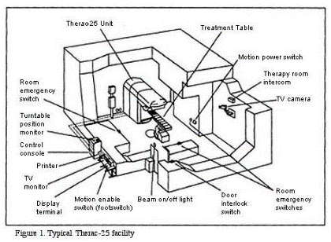
Correctness Requirements
Threaded programs must work for all interleavings of thread instruction sequences
Cooperating threads inherently non-deterministic and non-reproducible
Really hard to debug unless carefully designed!
Example: Therac-25
Machine for radiation therapy
Software control of electron accelerator and electron beam/ Xray production
Software control of dosage
Software errors caused the death of several patients
A series of race conditions on shared variables and poor software design
“They determined that data entry speed during editing was the key factor in producing the error condition: If the prescription data was edited at a fast pace, the overdose occurred.”

Slide 43
Motivating Example: “Too Much Milk”
Great thing about OS’s – analogy between problems in OS and problems in real life
Help you understand real life problems better
But, computers are much stupider than people
Example: People need to coordinate:
Time
Person A
Person B
3:00
Look in Fridge. Out of milk
3:05
Leave for store
3:10
Arrive at store
Look in Fridge. Out of milk
3:15
Buy milk
Leave for store
3:20
Arrive home, put milk away
Arrive at store
3:25
Buy milk
3:30
Arrive home, put milk away
Notes:
You’re sitting in class, hot day, milk does a body good. Go home, no milk, so go to store
Roommate leaves class late because prof is more long-winded than I am. Has same idea, but result is too much milk!
Problem: two cooperating threads, not cooperating properly

Slide 44
Solve with a lock?
Recall: Lock prevents someone from doing something
Lock before entering critical section
Unlock when leaving
Wait if locked
Important idea: all synchronization involves waiting
For example: fix the milk problem by putting a key on the refrigerator
Lock it and take key if you are going to go buy milk
Fixes too much: roommate angry if only wants OJ
Of Course – We don’t know how to make a lock yet
Let’s see if we can answer this question!
#$@%@#$@

Slide 45
Too Much Milk: Correctness Properties
Need to be careful about correctness of concurrent programs, since non-deterministic
Impulse is to start coding first, then when it doesn’t work, pull hair out
Instead, think first, then code
Always write down behavior first
What are the correctness properties for the “Too much milk” problem???
Never more than one person buys
Someone buys if needed
First attempt: Restrict ourselves to use only atomic load and store operations as building blocks

Slide 46

Too Much Milk: Solution #1
Use a note to avoid buying too much milk:
Leave a note before buying (kind of “lock”)
Remove note after buying (kind of “unlock”)
Don’t buy if note (wait)
Suppose a computer tries this (remember, only memory read/write are atomic):
if (noMilk) { if (noNote) { leave Note; buy milk; remove note; } }
Notes:
* This is a fate worse than failure! Code that usually works is way worse than outright broken code

Slide 47
Too Much Milk: Solution #1
Use a note to avoid buying too much milk:
Leave a note before buying (kind of “lock”)
Remove note after buying (kind of “unlock”)
Don’t buy if note (wait)
Suppose a computer tries this (remember, only memory read/write are atomic):
Thread A Thread B
if (noMilk) { if (noMilk) { if (noNote) {
if (noNote) { leave Note;
buy Milk;
remove Note;
}
}
leave Note;
buy Milk;
remove Note; } }
Notes:
* This is a fate worse than failure! Code that usually works is way worse than outright broken code

Slide 48
Too Much Milk: Solution #1
Use a note to avoid buying too much milk:
Leave a note before buying (kind of “lock”)
Remove note after buying (kind of “unlock”)
Don’t buy if note (wait)
Suppose a computer tries this (remember, only memory read/write are atomic):
if (noMilk) { if (noNote) { leave Note; buy milk; remove note; } }
Result?
Still too much milk but only occasionally!
Thread can get context switched after checking milk and note but before buying milk!
Solution makes problem worse since fails intermittently
Makes it really hard to debug…
Must work despite what the dispatcher does!
Notes:
* This is a fate worse than failure! Code that usually works is way worse than outright broken code

Slide 49

Too Much Milk: Solution #1½
Clearly the Note is not quite blocking enough
Let’s try to fix this by placing note first
Another try at previous solution:
leave Note;
if (noMilk) { if (noNote) { buy milk; } }
remove Note;
What happens here?
Well, with human, probably nothing bad
With computer: no one ever buys milk

Slide 50
Too Much Milk Solution #2
How about labeled notes?
Now we can leave note before checking
Algorithm looks like this:
Thread A Thread B
leave note A; leave note B; if (noNote B) { if (noNoteA) { if (noMilk) { if (noMilk) { buy Milk; buy Milk; } } } } remove note A; remove note B;
Does this work?
Possible for neither thread to buy milk
Context switches at exactly the wrong times can lead each to think that the other is going to buy
Really insidious:
Extremely unlikely this would happen, but will at worse possible time
Probably something like this in UNIX

Slide 51

Too Much Milk Solution #2: problem!
I’m not getting milk, You’re getting milk
This kind of lockup is called “starvation!”

Slide 52
Too Much Milk Solution #3
Here is a possible two-note solution:
Thread A Thread B
leave note A; leave note B; while (note B) {\\X if (noNote A) {\\Y do nothing; if (noMilk) { } buy milk; if (noMilk) { } buy milk; } } remove note B; remove note A;
Does this work? Yes. Both can guarantee that:
It is safe to buy, or
Other will buy, ok to quit
At X:
If no note B, safe for A to buy,
Otherwise wait to find out what will happen
At Y:
If no note A, safe for B to buy
Otherwise, A is either buying or waiting for B to quit

Slide 53
Case 1
“leave note A” happens before “if (noNote A)”
leave note A; while (note B) {\\X
do nothing; };
if (noMilk) {
buy milk; } } remove note A;
happened
before
leave note B; if (noNote A) {\\Y
if (noMilk) { buy milk;
} } remove note B;

Slide 54
Case 1
“leave note A” happens before “if (noNote A)”
leave note A; while (note B) {\\X
do nothing; };
if (noMilk) {
buy milk; } } remove note A;
happened
before
leave note B; if (noNote A) {\\Y
if (noMilk) { buy milk;
} } remove note B;

Slide 55
Case 1
“leave note A” happens before “if (noNote A)”
leave note A; while (note B) {\\X
do nothing; };
if (noMilk) {
buy milk; } } remove note A;
happened
before
leave note B; if (noNote A) {\\Y
if (noMilk) { buy milk;
} } remove note B;
Wait for note B to be removed

Slide 56
Case 2
“if (noNote A)” happens before “leave note A”
leave note A; while (note B) {\\X
do nothing; };
if (noMilk) {
buy milk; } } remove note A;
leave note B; if (noNote A) {\\Y
if (noMilk) { buy milk;
} } remove note B;
happened
before

Slide 57
Case 2
“if (noNote A)” happens before “leave note A”
leave note A; while (note B) {\\X
do nothing; };
if (noMilk) {
buy milk; } } remove note A;
leave note B; if (noNote A) {\\Y
if (noMilk) { buy milk;
} } remove note B;
happened
before

Slide 58
Case 2
“if (noNote A)” happens before “leave note A”
leave note A; while (note B) {\\X
do nothing; };
if (noMilk) {
buy milk; } } remove note A;
leave note B; if (noNote A) {\\Y
if (noMilk) { buy milk;
} } remove note B;
happened
before
Wait for note B to be removed

Slide 59
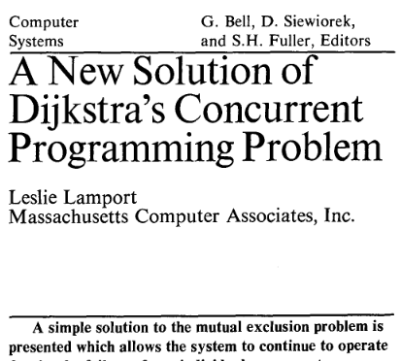

This Generalizes to $n$ Threads…
Leslie Lamport’s “Bakery Algorithm” (1974)

Slide 60
Solution #3 discussion
Our solution protects a single “Critical-Section” piece of code for each thread:
if (noMilk) { buy milk; }
Solution #3 works, but it’s really unsatisfactory
Really complex – even for this simple an example
Hard to convince yourself that this really works
A’s code is different from B’s – what if lots of threads?
Code would have to be slightly different for each thread
While A is waiting, it is consuming CPU time
This is called “busy-waiting”
There’s got to be a better way!
Have hardware provide higher-level primitives than atomic load & store
Build even higher-level programming abstractions on this hardware support

Slide 61
Too Much Milk: Solution #4?
Recall our target lock interface:
acquire(&milklock) – wait until lock is free, then grab
release(&milklock) – Unlock, waking up anyone waiting
These must be atomic operations – if two threads are waiting for the lock and both see it’s free, only one succeeds to grab the lock
Then, our milk problem is easy:
acquire(&milklock);
if (nomilk)
buy milk;
release(&milklock);

Slide 62
Where are we going with synchronization?
Programs
Shared Programs
Higher-level API
Locks Semaphores Monitors Send/Receive
Hardware
Load/Store Disable Ints Test&Set Compare&Swap
We are going to implement various higher-level synchronization primitives using atomic operations
Everything is pretty painful if only atomic primitives are load and store
Need to provide primitives useful at user-level

Slide 63
Conclusion
Every thread has both a user and kernel stack
Showed more details about context-switching mechanisms
Concurrent threads introduce problems when accessing shared data
Programs must be insensitive to arbitrary interleavings
Without careful design, shared variables can become completely inconsistent
Important concept: Atomic Operations
An operation that runs to completion or not at all
These are the primitives on which to construct various synchronization primitives
Showed a simple construction for a lock that uses interrupt disable mechanism
Must be very careful not to waste/tie up machine resources
Shouldn’t disable interrupts for long
Shouldn’t spin wait for long
Key idea: Separate lock variable, use hardware mechanisms to protect modifications of that variable

